Slide 1
In Our Own Words
doing research with young people instead of about them

Slide 2
Introduction
Seven partner organisations met in 2023.
Exploring new methods of participation and engaging with young people who are less often heard.
Submitted a partnership funding bid to NIHR (via ARC KSS) for a youth-led peer research project with a focus on mental health and neurodiversity.
The project kicked off at the beginning of this year, with a co-design group of young adults with lived experience shaping the programme design and delivery.
11 young people aged 12-20 with lived experience have now been trained by professional researchers from the University of Surrey.
They were supported to design and deliver their own research projects and have captured detailed feedback from 160 young people and professionals.
Today is a platform for these youth researchers to share their findings In Our Own Words.

Slide 3
The partnership group
Notes:
In Our Own Words is a funded by the National Institute of Health and Care Research, Applied Research Collaboration. The project is part of an initiative to support young people to engage in, get involved with, co-produce and co-design health and care research in relation to mental health.
Children and young people's mental health research a top priority across Kent, Surrey and Sussex
The project is in partnership with Mindworks, University of Surrey, Surrey Youth Focus, Healthwatch and Surrey Minority Ethic Forum. Representatives from each organisation form a governance group that meets monthly.

Slide 4
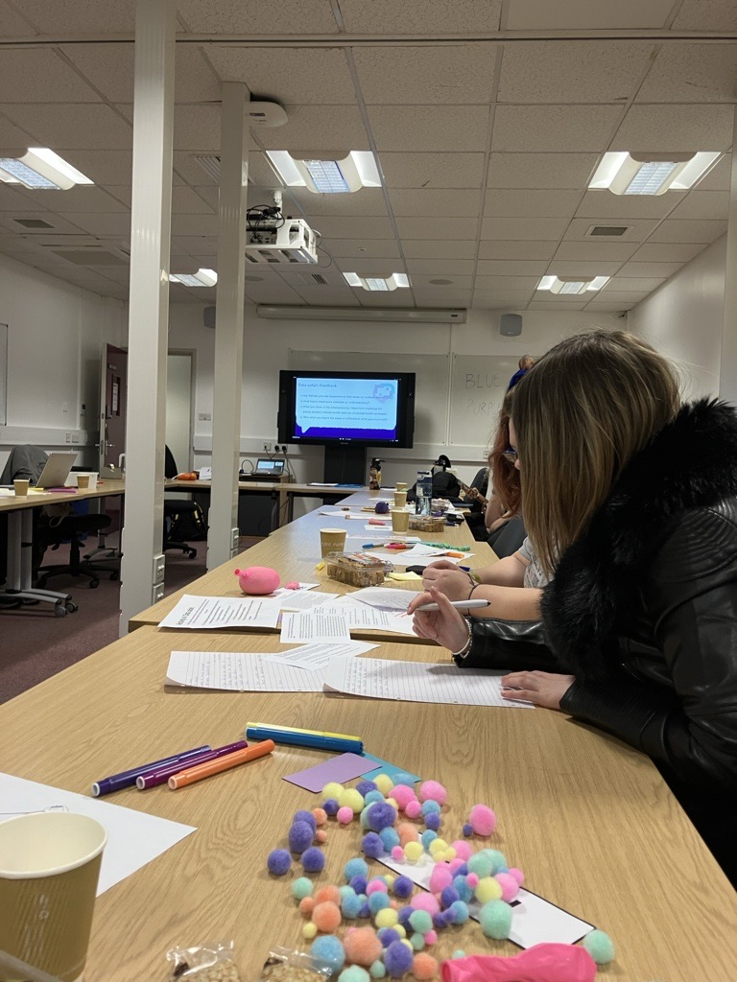
The project
11 young people (12-20) with lived experience of neurodiversity became Youth Researchers, trained in social research methods to explore questions around mental health.
The programme was co-produced by lived experienced experts, who have been involved in youth voice opportunities.
From March – October 2024, the Youth Researchers:
analysed existing research and insights – a data safari
learnt about the purpose of research, how to generate questions as well as different methods for collecting, analysing and presenting data
developed research questions with a key partner in their area of interest, for example with Surrey Police, commissioners and Mindworks
had their research questions approved by an ethics board
collected and analysed their own data, using their findings to form recommendations for positive change
worked with Surrey University researchers, Make Good Trouble (a social impact company) as well as Surrey Youth Voice to find accessible and creative ways to disseminate their findings
The 11 Youth Researchers received survey responses from a total of 160 young people, teachers, police officers and parent/carers.

Slide 5
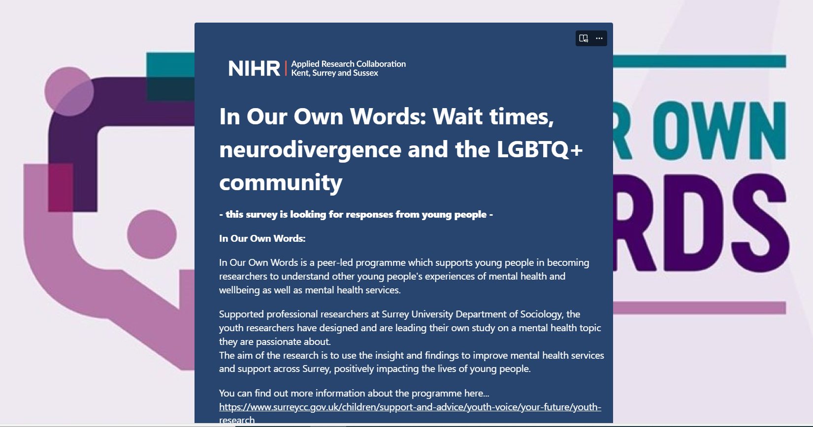
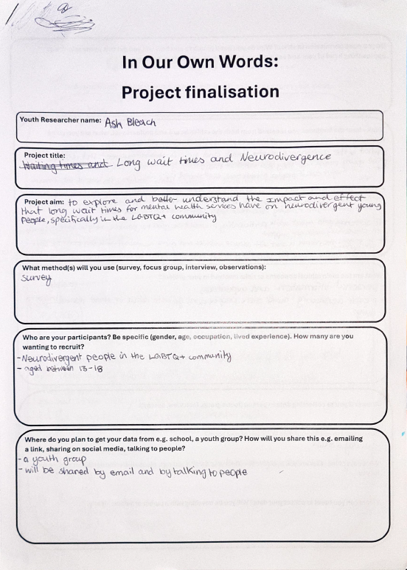
The Project Process
Notes:
Project process:
After the initial two months of training sessions, where youth researchers were introduced to social research, they were tasked with drafting their project proposals, known as study protocols. In these proposals, they outlined the rationale behind their research questions, identified their target participants, formulated their questions, and detailed their planned data analysis methods. Once completed, these proposals were submitted for review.
The proposals underwent an ethical approval process with partnership members from the University of Surrey. Additionally, we invited system leaders related to their research topics to provide project proposal feedback, offering suggestions on how the youth researchers’ investigations could align with ongoing transformation efforts. We sought commitment from these partners, asking how they would advocate for the youth researchers’ findings within their workstreams. This collaboration was viewed as a valuable opportunity to connect young researchers with decision-makers who influence the services they engage with.
Following feedback from both peers and professionals, the youth researchers completed a project finalisation. This finalisation enabled the In Our Own Words team to create a survey using Microsoft Forms. Researchers received a survey link and QR code to promote it within their communities. The survey ran from June 17th to August 12th, garnering 160 responses from young people, educators, parents, and members of Surrey Police. Each youth researcher received their data set and was supported in analysing the results during subsequent sessions.

Slide 6
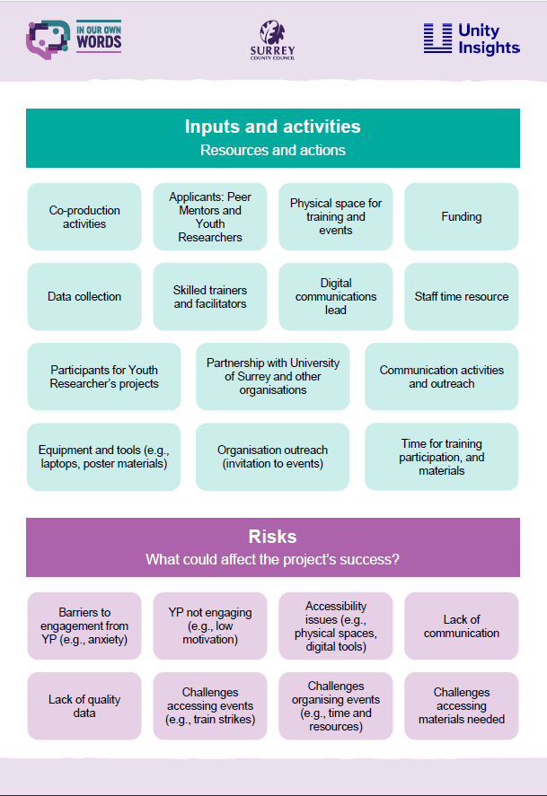
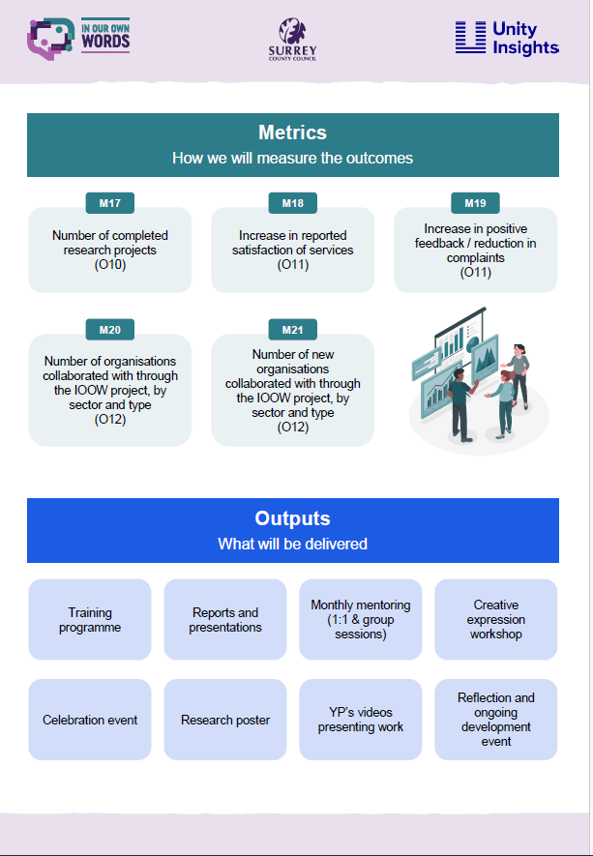
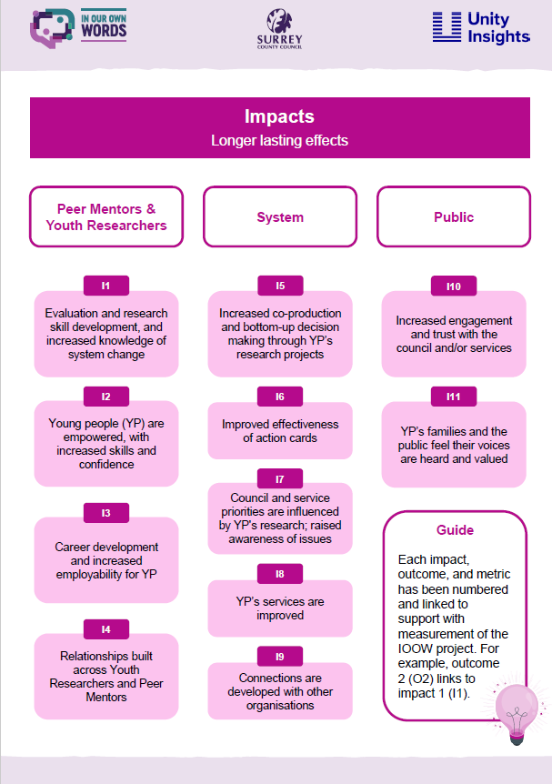
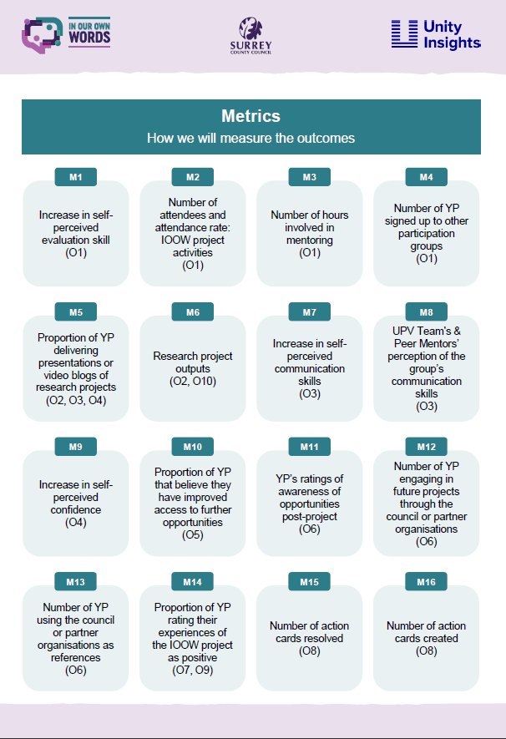
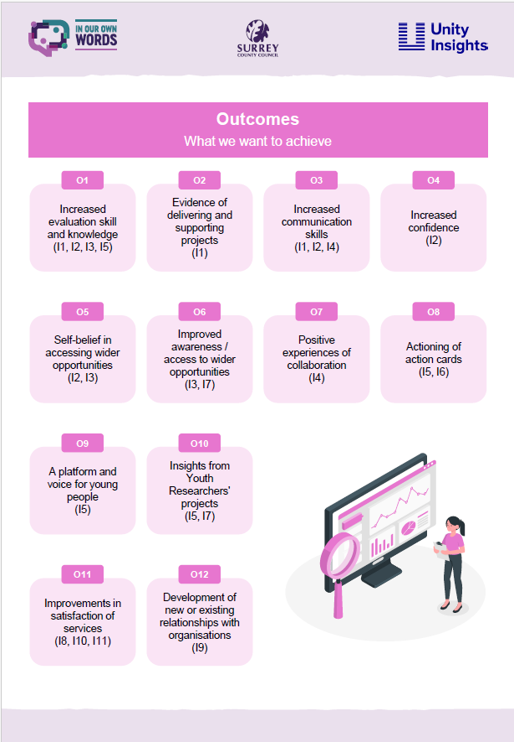
Evaluation
Notes:
In March 2024, Unity Insights led two workshops, educating In Our Own Words young person’s steering group on the importance and process of evaluation.
The steering group was made up of 4 lived experienced experts, who have had a history of engagement with Surrey Youth Voice. We wanted to provide a new opportunity for Surrey Youth Voice members to move beyond participation, gaining new knowledge and experience in the design and development of youth programmes,.
The young person created logic model will form our evaluation framework. If you are interested in reading the programme evaluation, please contact the Surrey Youth Voice team at user.voice@surreycc.gov.uk.

Slide 7
Youth researchers' key themes
Each of the research projects focused on different aspects of neurodivergence (ND) and mental health.
1. Experiences of waiting:
Wait times, neurodivergence and the LGBTQ+ community
The impacts of diagnosis waiting time (students' perspectives)
2. School-based support for ND young people:
The impact of diagnosis on support at school
Autistic girls' experiences of school in Surrey
Visiting the past to change the future: neurodiversity at school
3. Teacher training and support for ND students:
Teacher training on neurodiversity
The impacts of diagnosis waiting time (teachers)
4. Education and work-based avoidance:
How emotionally based school non-attendance impacts young people’s friendships and social relationships
The impact of mental health on education and work-based avoidance
5. Understanding of neurodivergence in the wider community:
Community safety and interactions between neurodivergent young people and the Police.
Perceptions of autism

Slide 8
Youth research findings
These are the summarised key findings for education and work-based non-attendance, and community support.
Non-Attendance challenges:
Mental Health Struggles: Non-attendance due to mental health struggles or inaccessible settings.
Impact on Friendships: EBSNA leads to loneliness and isolation; returning to school is challenging due to anxiety about what peers and teachers will say.
Importance of Recreational Activities:
Positive Impact: Recreational activities help maintain mental health and connections during time off.
Interactions with Police:
Pegasus Scheme: Helps individuals communicate with the police; needs better awareness and understanding.
Police Training: More training on neurodiversity is needed; practical advice and direct feedback from young people are beneficial.
Overall Insights:
Youth-Led Research: Provides valuable insights into the experiences and needs of neurodivergent young people.
Recommendations: Highlight priority areas for interventions and support to improve their experiences in schools and communities.
Notes:
For the purposes of this presentation, the findings have been summarised to highlight key insights. For a detailed look at all the feedback from young people, parents/carers, educators, and police staff in the community, please refer to the findings report. The report includes numerous quotes directly reflecting their experiences, providing a comprehensive understanding of the issues discussed.

Slide 9
Youth research findings continued
These are the summarised key findings for impact of waiting, diagnosis, school-based challenges and teacher training.
Impact of Waiting for Diagnosis and Support:
Significant Impact: Waiting for a diagnosis or mental health support negatively affects neurodiverse young people, causing uncertainty and worsening mental health.
Need for Support: Regular updates on wait times and interim support are crucial. 58% felt unsupported while waiting.
Challenges in School:
Improved Support Post-Diagnosis: Diagnosis helps teachers understand and support students better.
Primary vs. Secondary School: Primary schools generally provide better support.
Emotional Wellbeing: School often negatively impacts emotional wellbeing; autistic girls report masking.
Teacher Training Needs:
Regular Updates: Teachers need regular updated training on neurodiversity.
Supporting Multiple Conditions: Training should include support for students with multiple conditions.
Knowledge Rating: Teachers rated their knowledge of autism as average.
Notes:
For the purposes of this presentation, the findings have been summarised to highlight key insights. For a detailed look at all the feedback from young people, parents/carers, educators, and police staff in the community, please refer to the findings report. The report includes numerous quotes directly reflecting their experiences, providing a comprehensive understanding of the issues discussed.

Slide 10
Youth research recommendations
These recommendations are for supporting neurodivergent young people at school and in the community.
For the purposes of this presentation, the recommendations have been summarised. We encourage you to look at the full list of recommendations that are written in the youth researchers’ own words.
Prioritise reasonable adjustments: Ensure reasonable adjustments are applied universally to all students and are non-negotiable.
Offer Sensory Support Items: Provide items like fidgets to manage sensory challenges.
Create Quieter Classroom Environments: Manage noise levels and promote respectful behaviour.
Annual Teacher Training: Update training on neurodiversity annually, designed by neurodivergent young people.
Increase Awareness: Educate teachers on diverse processing needs and co-occurring conditions.
Support Emotionally Based School Non-Attendance (EBSNA): Provide tools, social scripts, and flexible timetables; foster empathy and psychological safety.
Promote Inclusive Activities: Encourage neurodivergent-friendly recreational activities and sports, as provision at school is not always inclusive.
For Surrey Police - Simplify Pegasus Scheme: Promote and simplify the scheme for better communication.
For Surrey Police - Train Police Officers: Provide regular training on neurodiversity supported by neurodivergent young people.
Notes:
Each of the research projects focused on different aspects of neurodivergence (ND) and mental health. For the purposes of this presentation, the recommendations have been summarised. We encourage you to review the full list of recommendations, which provides more detailed information expressed by the youth researchers in their own words.
While there is a lot of positive work happening across the system, such as the SEND improvement plan Local Area SEND Strategic Improvement Plan that is committed to making important changes to improve the lives of neurodivergent young people and their families, we recognise some of these recommendations may already be in progress.
However, these recommendations are invaluable in offering direction and highlighting the experiences of young neurodivergent individuals in schools and the community. They pinpoint areas where young people feel that focus is needed and where interventions and support should be prioritized.
Youth-led research provides us with valuable insights into the current experiences and feelings of children and young people. It highlights priority areas where interventions and support need more focus and implementation, ensuring that young people can feel the impact in their schools and communities.

Slide 11
Youth research recommendations continued
These recommendations are for Supporting neurodivergent young people on the waitlist.
For the purposes of this presentation, the recommendations have been summarised. We encourage you to look at the full list of recommendations that are written in the youth researchers’ own words.
Inform Schools and Train Staff: Notify schools when a student is on the waitlist and train staff on providing empathetic support.
Offer Reasonable Adjustments: Provide learning breaks and time-out cards to help students cope.
Establish Support Groups: Create groups for students to share experiences and build connections.
Provide Regular Updates: Send updates on the diagnostic process to manage expectations and reduce anxiety.
Increase Support Groups: Expand groups for emotional support and practical advice.
Create Co-Production Groups: Empower young people to share issues and propose solutions.
Notes:
Each of the research projects focused on different aspects of neurodivergence (ND) and mental health. For the purposes of this presentation, the recommendations have been summarised. We encourage you to review the full list of recommendations, which provides more detailed information expressed by the youth researchers in their own words.
While there is a lot of positive work happening across the system, such as the SEND improvement plan Local Area SEND Strategic Improvement Plan that is committed to making important changes to improve the lives of neurodivergent young people and their families, we recognise some of these recommendations may already be in progress.
However, these recommendations are invaluable in offering direction and highlighting the experiences of young neurodivergent individuals in schools and the community. They pinpoint areas where young people feel that focus is needed and where interventions and support should be prioritized.
Youth-led research provides us with valuable insights into the current experiences and feelings of children and young people. It highlights priority areas where interventions and support need more focus and implementation, ensuring that young people can feel the impact in their schools and communities.

Slide 12
Youth research: early intervention and prevention
“Schools shouldn’t require professionals to provide evidence that I was struggling”
“They refused to make reasonable adjustments as they didn’t have the resources to support me so I had to stop attending as I couldn’t cope with it, and they couldn’t keep me safe”
“I needed a reason I felt so out of place”
School-based support and inclusive school environments
Waiting list / support access for diagnostic and mental health services
Emotionally based school non-attendance (EBSNA)
“Many of us with or without diagnosis are sent through mainstream schools that cannot accommodate our needs”
“Once you stop attending it’s 1000x harder to go back because of the anxiety around what people are going to say when they see you again”
“I just expected the worst all the time as the damage was done. If only they supported me earlier instead of just thinking I was lazy and didn’t care”
Notes:
In October, the In Our Own Words youth researchers presented their findings to members of ATLAS, a Surrey Youth Voice Participation group for young people with additional needs and disabilities. The youth researchers wanted the opportunity to present their findings to members of the neurodivergent community to sense check their research and see if it was applicable, acceptable and helpful to other neurodivergent / autistic young people
Members of ATLAS noticed that all the different research projects could be grouped into three different experiences, tapping into each stage a neurodivergent young person may go through in education.
Struggling with accessing support at school
Perusing a diagnosis to access support
Experiencing challenges and barriers due to wait times, potentially leading to school absence
The findings from the youth research project and conversations with ATLAS highlight a challenge and potential trajectory in the educational journey of neurodivergent young people, emphasising the need for early intervention and systemic changes within schools.
Early School Support and Inclusive Environments
Inclusive settings and proactive support at school, where reasonable adjustments are prioritised can help neurodivergent young people thrive.
Lack of early accommodations leads families to seek diagnoses to unlock necessary resources and adjustments.
Barriers Due to Diagnosis Wait Times
Long delays for diagnosis (for Autism, Neurodivergence, and mental health needs) Increase educational and mental health challenges.
The unmet need for reasonable adjustments intensifies family stress and anxiety.
Impact of Prolonged Waiting
The combination of inadequate support and delayed diagnosis leads to heightened anxiety, trauma, and, for some, disengagement from education altogether, leading to Emotionally Based School Non-Attendance (EBSNA)
Families may reach a crisis point, requiring more intensive downstream interventions.
The Opportunity for Upstream Change
Empowering schools to act as buffers with training and resources to create inclusive environments and accommodate reasonable adjustments may intersect challenges from arising and reduce reliance on clinical diagnoses for support.
Having support in place early and creating inclusive school environments, where adjustments are normalised, will not only benefit neurodivergent young people but can create a better learning environment for all students.

Slide 13
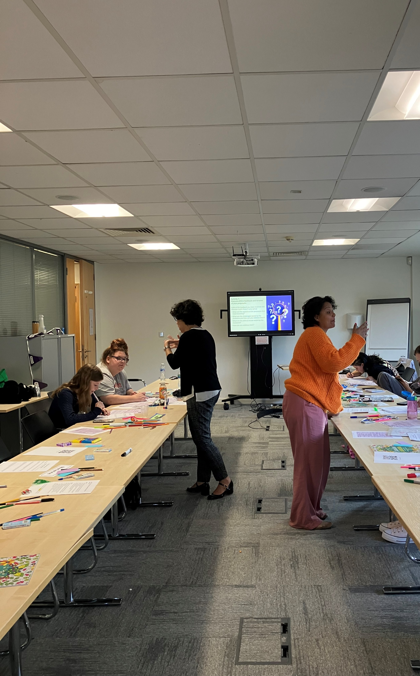
Moving forward…
Our avenues to implement youth research recommendations include…
Surrey Youth Voice Action Card Governance:
When 4 or more young people want change an action card is created.
Youth research can support existing action cards (ATLAS & CYA).
Utilise the UVP team’s existing pathways, feeding into governance structures for Additional Needs and Disabilities and Mental Health.
Working in partnership: health, academia and the third sector
Continue working in partnership within In Our Own Words governance organisations to extend influence of youth research and community priorities.
Collaboration with teams and projects that will benefit from programme outputs and youth-led insights.
Working in the community: Mental Health Support Teams (MHSTs)
UVP team has a new MHST participation lead role, sitting between SCC and SABP.
Youth research and recommendations can be taken directly to schools and shape the developing MHST participation model.

Slide 14
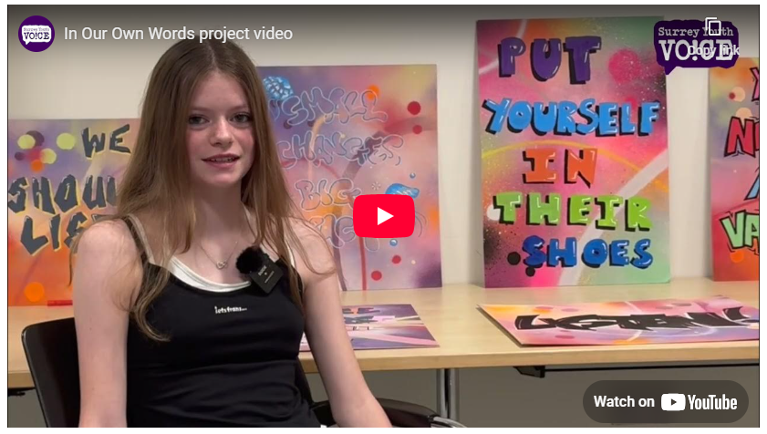
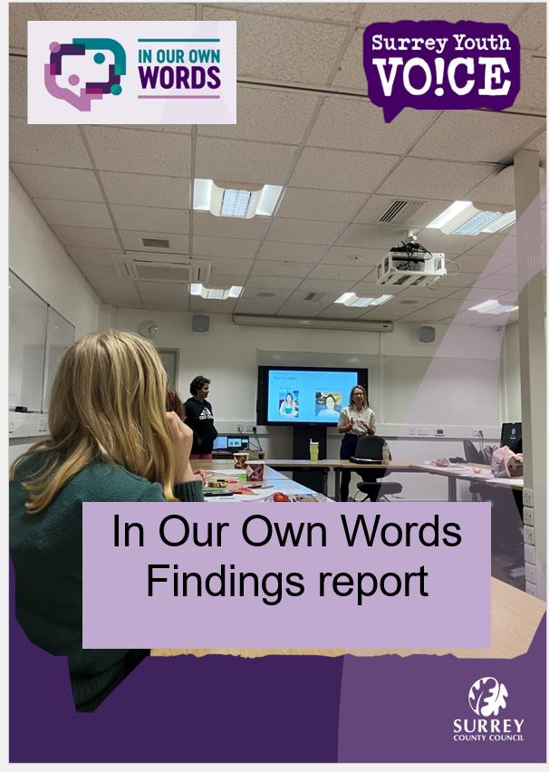
In Our Own Words: information pack
Project video
Impact story
Findings report
Comic book
Youth researcher recommendations
Notes:
In Our Own Words has created a set of materials as part of the project information pack. This is so the findings of youth-led research can be shared far and wide with the goal of positively benefiting services. These materials are available on the Surrey Youth Voice sharepoint (Surrey Youth Voice – Home) or by request.
The In Our Own Words team and youth researchers hope you find this information valuable in understanding the needs of neurodivergent young people in Surrey and supporting their mental health. If you use the youth researcher findings for any work or projects, let us know! Please contact us at user.voice@surreycc.gov.uk. This helps us monitor the impact of our work and provide feedback to our youth researchers on how their research has been utilized. It's important for young people to see the impact of their hard work and understand how they are contributing to positive changes.
Visit In Our Own Words - Youth Researchers - Surrey County Council to find out more information and stay updated.

Slide 15
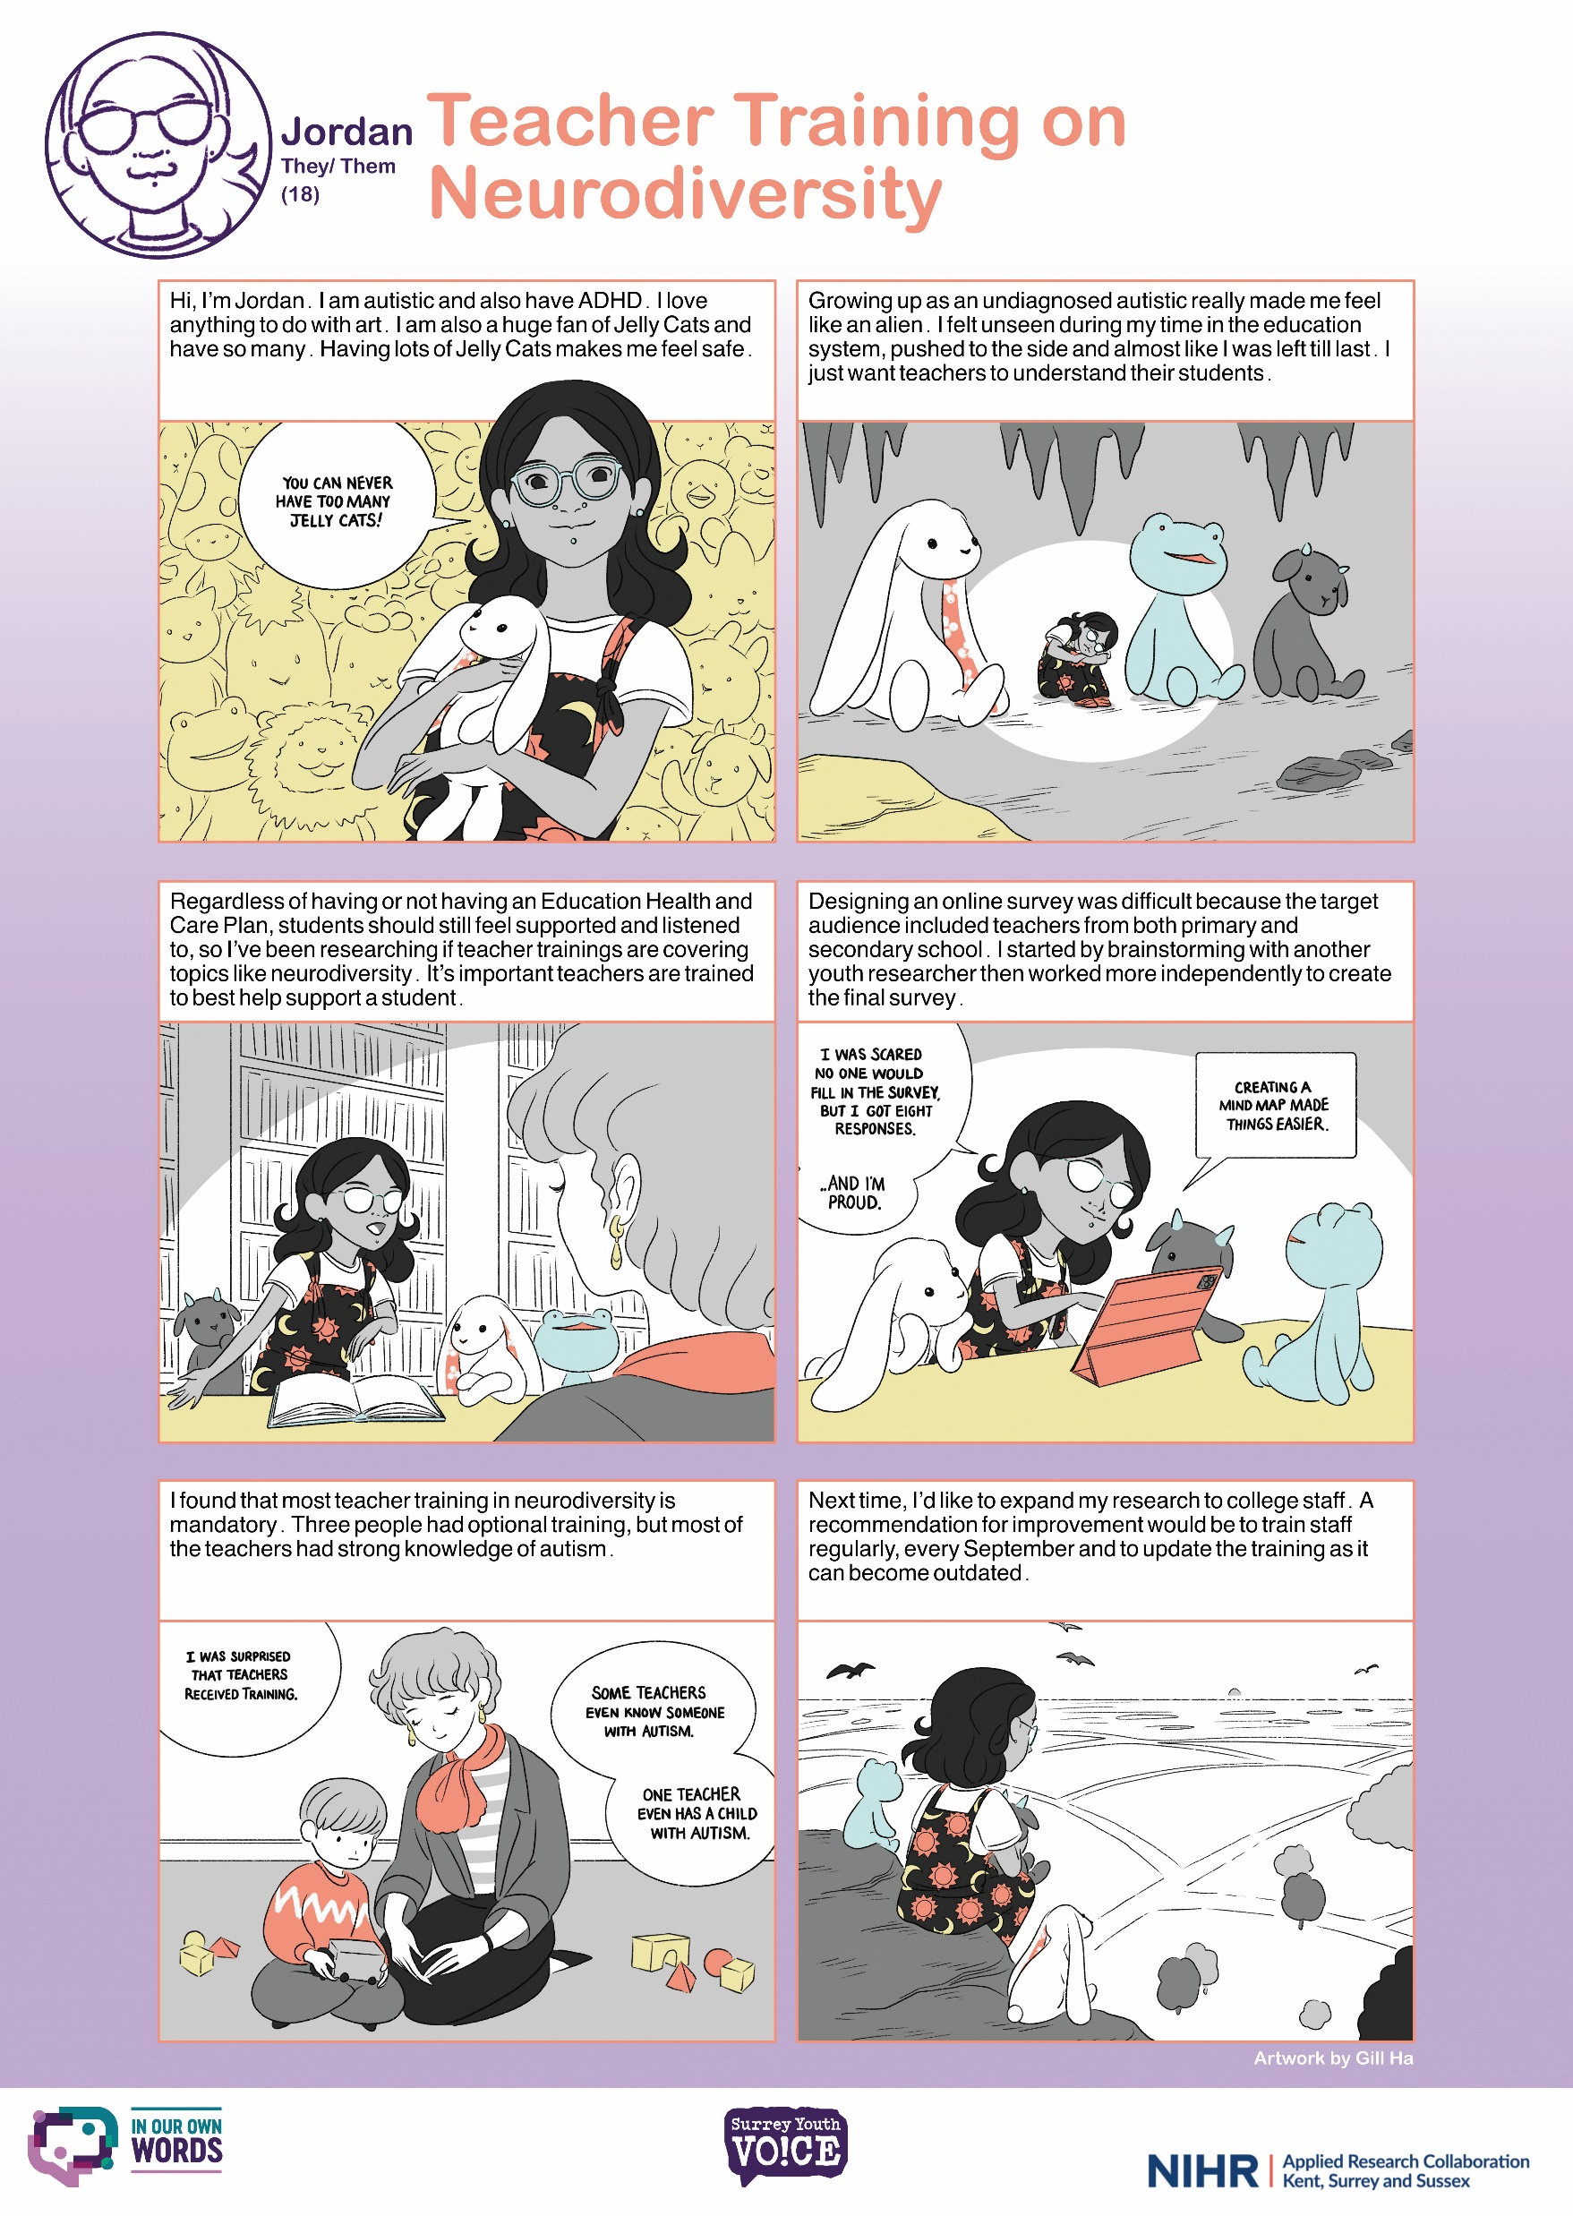
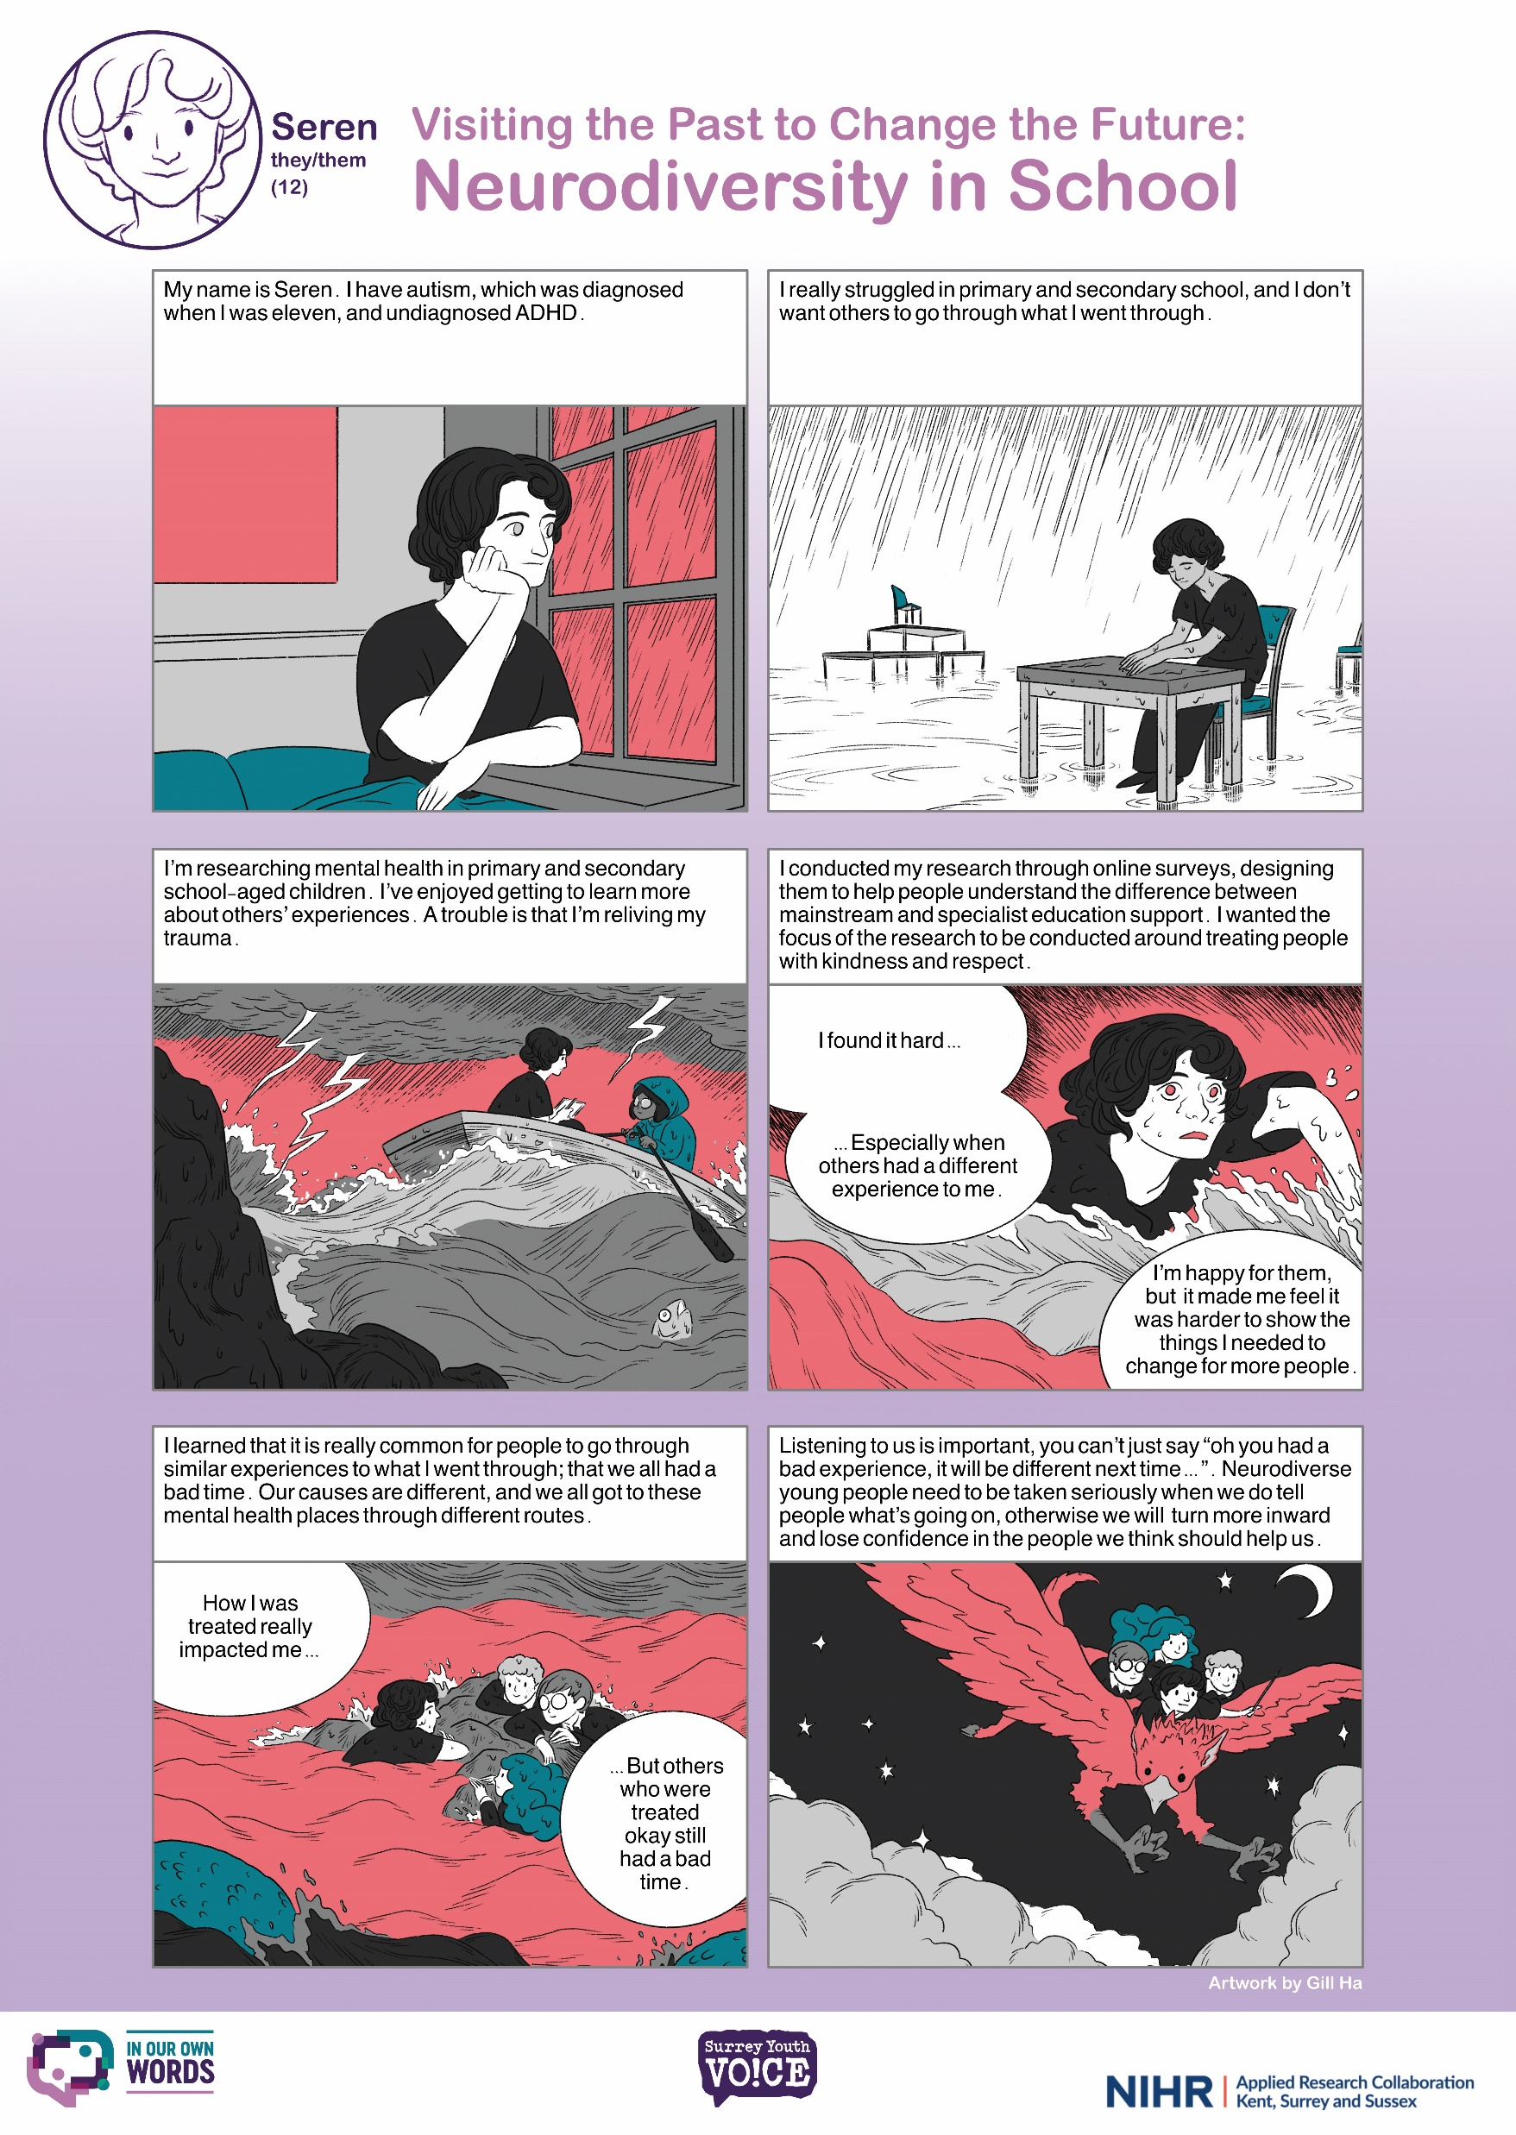
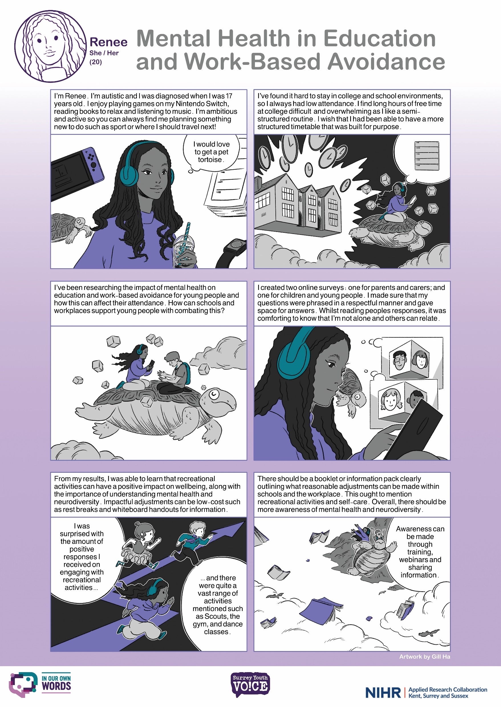
Youth researcher comics.
Notes:
Youth researchers have collaborated with a professional illustrator to create their own comic stories that highlight their findings, recommendations, and experiences within the programme. We aim to share these engaging comics widely, reaching everyone from young people to educators, parents, carers, and professionals. By presenting youth research in such a creative format, we hope to attract the attention of young people as well as professionals, to foster a deeper understanding of the experiences of neurodivergent young people in Surrey. Our goal is to promote inclusive, accessible, and neurodivergent-friendly practices through this original approach to sharing knowledge.

Slide 16
Thank you to all the young people!
Ems
Renee
Ellie C
Lois
Ash
Freya
Seren
Jordan
Marianne
Amber
Evie
Ellie B
Keira

Slide 17
In Our Own Words - Youth Researchers - Surrey County Council user.voice@surreycc.gov.uk

